Slide 1
Week 3
Alexey V. Zimin
JHU BME 580.417

Slide 2
Alignment of two genomes
Consider two genomes, each in many contiguous pieces (contigs), M and N, of average size m and n
Each Smith-Waterman contig-to-contig alignment would include doing O(m*n) operations, and we have to do it M*N times, so the total cost is O(M*N*m*n)
A solution is to seed the alignments with short exact matches:
Maximal Exact Matches (MEMs), based on suffix tree or suffix array
Minimizers
Then do Smith-Waterman in-between the seeds

Slide 3
K-mers
K-mer is a subsequence of length K of a genomic sequence
A genomic sequence of length L has L-K+1, K-mers
A K-mer is canonical if it comes before its reverse complement in lexicographic order
These two 10-mers are the same, the canonical one is in the red GCTAGAGACT AGTCTCTAGC

Slide 4
Using K-mers to seed alignments
AGATAGATAGACAACATAGACT
1 AGATAGAAA
7 ATACACAAC
15 CACAGACT

Slide 5
Using K-mers to seed alignments
AGATAGATAGACAACATAGACT
1 AGATA (5)
2 GATAG
ATAGA (7,15)
TAGAT
AGATA (1)
GATAG
ATAGA (3,16)
TAGAC (17)
AGACA
GACAA
ACAAC
CAACA
AACAT
ACATA
CATAG
ATAGA (7,3)
TAGAC (8)
AGACT
AGATAGAAA
ATACACAAC
CACAGACT

Slide 6
Using K-mers to seed alignments
AGATAGATAGACAACATAGACT
AGATA (1,5)
GATAG (2)
ATAGA (3,7,16)
TAGAT (4)
GATAG (6)
TAGAC (8,17)
AGACA (9)
GACAA (10)
ACAAC (11)
CAACA (12)
AACAT (13)
ACATA (14)
CATAG (15)
AGACT (18)
AGATAGAAA
ATACACAAC
CACAGACT

Slide 7
Using K-mers to seed alignments
AGATAGATAGACAACATAGACT
AGATA (1,5)
GATAG (2)
ATAGA (3,7,16)
TAGAT (4)
GATAG (6)
TAGAC (8,17)
AGACA (9)
GACAA (10)
ACAAC (11)
CAACA (12)
AACAT (13)
ACATA (14)
CATAG (15)
AGACT (18)
AGATAGAAA
Implied position:
1,1,5
CACAGACT
ATACACAAC

Slide 8
Using K-mers to seed alignments
AGATAGATAGACAACATAGACT
AGATA (1,5)
GATAG (2)
ATAGA (3,7,16)
TAGAT (4)
GATAG (6)
TAGAC (8,17)
AGACA (9)
GACAA (10)
ACAAC (11)
CAACA (12)
AACAT (13)
ACATA (14)
CATAG (15)
AGACT (18)
AGATAGAAA
Implied positions:
1,1,5
CACAGACT
Implied positions:
15
ATACACAAC
Implied positions:
7

Slide 9
Method of minimizers
Using all K-mers is expensive!!!
You can think of reducing the number (use every other one?)
An effective way to use fewer K-mer alignment seeds is method of minimizers
Smaller memory footprint and much faster for large data sets (e.g. computing overlaps between reads, or mapping the reads to a genome)
Does not require computing an index
Less sensitive

Slide 10
Numerical value of a K-mer
A K-mer uniquely corresponds to an integer:
A=0
C=1
G=2
T=3
Use base 4: AGT=0+2*4+3*16
Equivalent to Minimum Perfect Hash K-mers ⬄ integers
def kmer2int(kmer):
nt_map = {'A': 0, 'C': 1, 'G': 2, 'T': 3}
val = 0
pow=1
for i, nt in enumerate(kmer):
val += nt_map[nt] * pow
pow=pow*4
return val
# Example usage
kmer = "ACGT"
print(f"The numerical of '{kmer}' is: {kmer2int(kmer)}")

Slide 11
Minimizers
Minimizers are a subset of K-mers from a string, with the guarantee that similar set of K-mers will be chosen on similar strings.
Parameterized by:
K-mer length k
window length w
ordering of k-mers (by numerical value or lexicographical)
Can minimize numerical value or lexicographic value
Make sure to use canonical k-mers or take minimum value of k-mer and its reverse complement!!!

Slide 12
Example of minimizers
Consider genomic string: GCCCATGACTCGCATGCTGACATGCTGCTAGCT
Let k=10, w=5
Minimize numerical values
The first 5 K-mers: GCCCATGACT = 863318 CCCATGACTC = 477973 CCATGACTCG = 643781 CATGACTCGCA = 423089 ATGACTCGCAT = 3251500

Slide 13
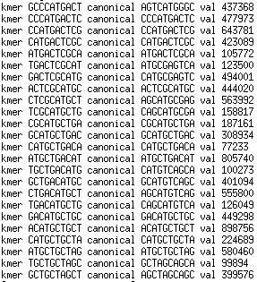
Example of minimizers
Consider genomic string: GCCCATGACTCGCATGCTGACATGCTGCTAGCT
Let k=10, w=5
minimizer

Slide 14
Example of minimizers
Consider genomic string: GCCCATGACTCGCATGCTGACATGCTGCTAGCT
Let k=10, w=5
minimizer

Slide 15
Example of minimizers
Consider genomic string: GCCCATGACTCGCATGCTGACATGCTGCTAGCT
Let k=10, w=5
minimizer

Slide 16
Example of minimizers
Consider genomic string: GCCCATGACTCGCATGCTGACATGCTGCTAGCT
Let k=10, w=5
minimizer

Slide 17
Example of minimizers
Consider genomic string: GCCCATGACTCGCATGCTGACATGCTGCTAGCT
Let k=10, w=5
minimizer

Slide 18
Example of minimizers
Consider genomic string: GCCCATGACTCGCATGCTGACATGCTGCTAGCT
Let k=10, w=5
minimizer
minimizer

Slide 19
Example of minimizers
Consider genomic string: GCCCATGACTCGCATGCTGACATGCTGCTAGCT
Let k=10, w=5
minimizer
minimizer
minimizer

Slide 20
Example of minimizers
Consider genomic string: GCCCATGACTCGCATGCTGACATGCTGCTAGCT
Let k=10, w=5
minimizer
minimizer
minimizer

Slide 21
Example of minimizers
Consider genomic string: GCCCATGACTCGCATGCTGACATGCTGCTAGCT
Let k=10, w=5
minimizer
minimizer
minimizer
minimizer

Slide 22
Example of minimizers
Consider genomic string: GCCCATGACTCGCATGCTGACATGCTGCTAGCT
Let k=10, w=5
minimizer
minimizer
minimizer
minimizer
minimizer
minimizer
minimizer

Slide 23
Seeding alignments with minimizers
Consider genomic strings: GCCCATGACTCGCATGCTGACATGCTGCTAGCT ACCCATGACTCGCA-GATGACATGCTGCTAGAT

Slide 24
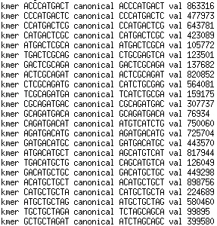
Seeding alignments with minimizers
Consider genomic strings: GCCCATGACTCGCATGCTGACATGCTGCTAGCT ACCCATGACTCGCA-GATGACATGCTGCTAGAT
minimizer
minimizer
minimizer
minimizer
minimizer
minimizer
minimizer
minimizer
minimizer
minimizer
minimizer
minimizer
minimizer

Slide 25
Seeding alignments with minimizers
Consider genomic strings: GCCCATGACTCGCATGCTGACATGCTGCTAGCT ACCCATGACTCGCA-GATGACATGCTGCTAGAT
minimizer
minimizer
minimizer
minimizer
minimizer
minimizer
minimizer
minimizer
minimizer
minimizer
minimizer
minimizer
minimizer

Slide 26
Seeding alignments with minimizers
Alignment: GCCCATGACTCGCATGCTGACATGCTGCTAGCT ||||||||||||| | |||||||||||||| | ACCCATGACTCGCA-GATGACATGCTGCTAGAT
You can do Smith-Waterman in-between the exact matches!

Slide 27
Seeding alignments with minimizers
Alignment: GCCCATGACTCGCATGCTGACATGCTGCTAGCT ||||||||||||| | |||||||||||||| | ACCCATGACTCGCA-GATGACATGCTGCTAGAT
You can do Smith-Waterman in-between the exact matches!

Slide 28
Using minimizers to compute candidate alignments
Read R1 minimizers M1 at O1, M2 at O2 M3 at O3
Read R2 minimizers M4 at O4, M1 at O5 M2 at O6
Read R3 minimizers M3 at O7, M5 at O8
Build MRO file:
M1 R1 O1
M2 R1 O2
M3 R1 O3
M4 R2 O4
M1 R2 O5
M2 R2 O6
M3 R3 O7
M5 R3 O8
M1 R1 O1
M1 R2 O5
M2 R1 O2
M2 R2 O6
M3 R1 O3
M3 R3 O7
M4 R2 O4
M5 R3 O8
M1 R1 O1, R2 O5
M2 R1 O2, R2 O6
M3 R1 O3, R3 O7
M4 R2 O4
M5 R3 O8
Sort by minimizer
Collect reads
Check alignments

Slide 29
Lab 2: minimizers
DUE Friday September 19 at 8:00pm
CODE (100% undergrad, 80% grad): Write three python functions to compute minimizers for a genomic sequence:
reverse_complement(seq): returns reverse complement of a sequence seq
compute_num_value(seq): returns numerical value of sequence seq (A=0,C=1,G=2,T=3), base 4 starting with the first letter
For each k-mer compute numerical value forward and reverse, use minimum
compute_minimizers(seq,k,w): computes minimizers for sequence seq, k-mer k, and window w, returns an array containing 0-based leftmost position of each minimizer
Submit code through autograder, name code minimizers.py
FIGURE (20% graduate students ONLY):
Generate random sequence G 100,000 bp long
Assume K=17, vary w from 1 to 16
How does the number of minimizers N vary with w?
Submit plot of N(w) – graduate students only, pdf, png or jpeg format, use log scale on y axis

Slide 30
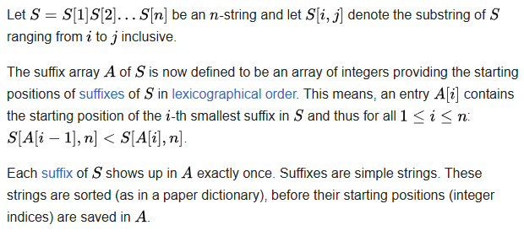
Data Structure: Suffix Array
Introduced by Manber & Myers (1990)
Cost to build: O(n² log n), cost to look up: O(m+log n), where m is the length of the query sequence and n is the length of the reference

Slide 31
Building a suffix array
Genome string TAGCAATG$
$ denotes the end of the string
Suffixes: 0 TAGCAATG$ 1 AGCAATG$ 2 GCAATG$ 3 CAATG$ 4 AATG$ 5 ATG$ 6 TG$ 7 G$ 8 $

Slide 32
Building a suffix array
Lexicographic order: $<A<C<G<T
Sort suffixes, record indices in an array: 8 $ 4 AATG$ 1 AGCAATG$ 5 ATG$ 3 CAATG$ 7 G$ 2 GCAATG$ 0 TAGCAATG$ 6 TG$
We cannot afford to store all these subsequences! Store just the indices!

Slide 33
Looking up in suffix array
Query sequence: GCAA
Binary search of the array, first look for strings starting with a G: Hi-> 8 $ 4 AATG$ 1 AGCAATG$ 5 ATG$ Starts with a G? -> 3 CAATG$ 7 G$ 2 GCAATG$ 0 TAGCAATG$ Lo-> 6 TG$

Slide 34
Looking up in suffix array
Query sequence: GCAA
When a match is found, go up and down to find all matching positions: 8 $ 4 AATG$ 1 AGCAATG$ 5 ATG$ Hi-> 3 CAATG$ 7 G$ Starts with a G? -> 2 GCAATG$ 0 TAGCAATG$ Lo-> 6 TG$

Slide 35
Looking up in suffix array
Query sequence: GCAA
When a match is found, go up and down to find all matching positions : 8 $ 4 AATG$ 1 AGCAATG$ 5 ATG$ 3 CAATG$ Hi -> Starts w GC? 7 G$ Lo -> Starts w GC? 2 GCAATG$ 0 TAGCAATG$ 6 TG$

Slide 36
Looking up in suffix array
Query sequence: GCAA
Found a perfect match: 8 $ 4 AATG$ 1 AGCAATG$ 5 ATG$ 3 CAATG$ 7 G$ Perfect match 2 GCAATG$ 0 TAGCAATG$ 6 TG$

Slide 37
Looking up in suffix array
Found a perfect match or unable to find longer match
When a match is found, go up and down to find all matching positions: 8 $ 4 AATG$ 1 AGCAATG$ 5 ATG$ 3 CAATG$ 7 G$ Perfect match 2 GCAATG$ 0 TAGCAATG$ 6 TG$

Slide 38
Perfect and imperfect matches
String match: TAGCAATG$ GCAA at position 2
What about imperfect matches , e.g. GCAT?

Slide 39
Looking up in suffix array
Query sequence: GCAT
Found a partial match – is it long enough to keep?: 8 $ 4 AATG$ 1 AGCAATG$ 5 ATG$ 3 CAATG$ 7 G$ Partial match 2 GCAATG$ 0 TAGCAATG$ 6 TG$

Slide 40
Example of alignment of two sequences
Start at the beginning of the query, find the longest match(es)
Indexed reference GCCCATGACTCGCATGCTGACATGCTGCTAGCT
Query TCGCATGCTTCATGGTGCTTGCTA

Slide 41
Alignment of two sequences
Start at the beginning of the query, find the longest match(es)
Indexed reference GCCCATGACTCGCATGCTGACATGCTGCTAGCT
TCGCATGCTTCATGGTGCTAGCTA

Slide 42
Alignment of two sequences
Start at the beginning of the query, find the longest match(es)
Indexed reference GCCCATGACTCGCATGCTGACATGCTGCTAGCT
TCGCATGCTTCATGGTGCTAGCTA

Slide 43
Alignment of two sequences
Use minimum matching length of 5 to avoid repetitive matches
Indexed reference GCCCATGACTCGCATGCTGACATGCTGCTAGCT
TCGCATGCTTCATGGTGCTAGCTA

Slide 44
Alignment of two sequences
Use minimum matching length of 5 to avoid repetitive matches
Indexed reference GCCCATGACTCGCATGCTGACATGCTGCTAGCT
TCGCATGCTTCATGGTGCTAGCTA

Slide 45
Alignment of two sequences
Do Smith-Waterman between the matching seeds
Indexed reference GCCCATGACTCGCATGCTGACATGCTGCTAGCT ||||||||| |||| |||||||| TCGCATGCTT-CATGGTGCTAGCTA
Compute alignment score based on Smith-Waterman alignment

Slide 46
Burrows-Wheeler Transform
Burrows-Wheeler Transform (BWT) is used to create efficient index of a sequence compared to just using the suffix array
BWT rearranges a character string into runs of similar characters, in a manner that can be reversed to recover the original string.
Used in bzip2 compression algorithm
Pairs with suffix array to create an efficient index into genome sequence

Slide 47
Burrows-Wheeler Transform
Example: BANANA$
All rotations: 0 BANANA$ 1 ANANA$B 2 NANA$BA 3 ANA$BAN 4 NA$BANA 5 A$BANAN 6 $BANANA
Sort in lexicographic order: 6 $BANANA 5 A$BANAN 3 ANA$BAN 1 ANANA$B 0 BANANA$ 4 NA$BANA 2 NANA$BA

Slide 48
Burrows-Wheeler Transform
Example: BANANA$
All rotations: 0 BANANA$ 1 ANANA$B 2 NANA$BA 3 ANA$BAN 4 NA$BANA 5 A$BANAN 6 $BANANA
Sort in lexicographic order: 6 $BANAN A 5 A$BANA N 3 ANA$BA N 1 ANANA$ B 0 BANANA $ 4 NA$BAN A 2 NANA$B A
Suffix Array:
6 5 3 1 0 4 2
BWT:
ANNB$AA

Slide 49
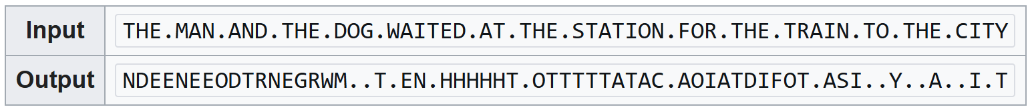
BWT rationale
If the original string had several substrings that occurred often, then the BWT-transformed string will have several places where a single character is repeated many times in a row, creating more-easily-compressible data.
Example:

Slide 50
BWT reversibility
A N N B $ A A
$A
A
A BN N
A$ NA
NA
BA $B AN AN
$B A$
AN
AN
BA NA NA
A$B NA$
NAN
BAN
$BA ANA ANA
$BA A$B
ANA
ANA
BAN NA$ NAN
A$BA NA$B
NANA
BANA
$BAN ANA$ ANAN
Sort
Add
Sort
Add
Sort
Add

Slide 51
BWT reversibility
A$BA NA$B
NANA
BANA
$BAN ANA$ ANAN
$BAN A$BA
ANA$
ANAN
BANA NA$B NANA
A$BAN NA$BA
NANA$
BANAN
$BANA ANA$B ANANA
$BANA
A$BAN
ANA$B
ANANA
BANAN NA$BA NANA$
A$BANA
NA$BAN
NANA$B
BANANA
$BANAN ANA$BA ANANA$
$BANAN
A$BANA
ANA$BA
ANANA$
BANANA NA$BAN NANA$B
Sort
Add
Sort
Add
Sort

Slide 52
BWT reversibility
A$BANAN
NA$BANA
NANA$BA
BANANA$
$BANANA ANA$BAN ANANA$B
$BANANA
A$BANAN
ANA$BAN
ANANA$B
BANANA$ NA$BANA NANA$BA
Add
Sort

Slide 53
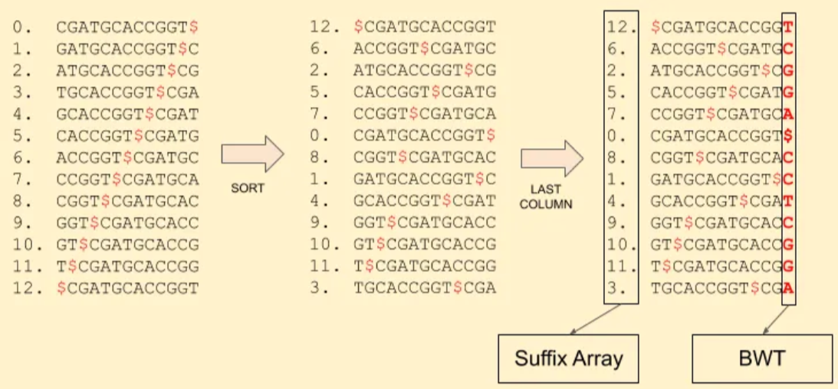
Using BWT and SA for sequence alignments
Reference sequence: CGATGCACCGGT:

Slide 54
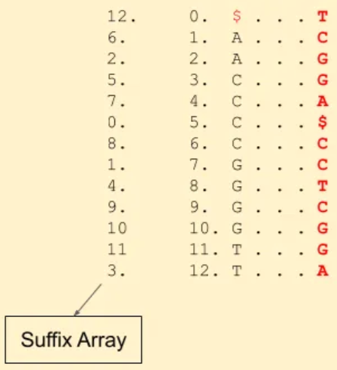
Using BWT and SA for sequence alignments
Reference sequence: CGATGCACCGGT,
Match read TGCA
Start at the end, look for A’s in the SA
Find which of the A’s are followed by C -- 1st C in the BWT, look at the 1st C in the SA

Slide 55
Using BWT and SA for sequence alignments
Reference sequence: CGATGCACCGGT,
Match read TGCA
Start at the end, look for A’s in the SA
Find which of the A’s are followed by C -- 1st C in the BWT, look at the 1st C in the SA
Is that C followed by a G -- yes, 2nd G in the BWT

Slide 56
Using BWT and SA for sequence alignments
Reference sequence: CGATGCACCGGT,
Match read TGCA
Start at the end, look for A’s in the SA
Find which of the A’s are followed by C -- 1st C in the BWT, look at the 1st C in the SA
Is that C followed by a G -- yes, 2nd G in the BWT
Is the G followed by a T -- yes, 2nd T in the BWT

Slide 57
Using BWT and SA for sequence alignments
Reference sequence: CGATGCACCGGT,
Match read TGCA
Start at the end, look for A’s in the SA
Find which of the A’s are followed by C -- 1st C in the BWT, look at the 1st C in the SA
Is that C followed by a G -- yes, 2nd G in the BWT
Is the G followed by a T -- yes, 2nd T in the BWT

Slide 58
Using BWT and SA for sequence alignments
Reference sequence: CGATGCACCGGT,
Match read TGCA
Start at the end, look for A’s in the SA
Find which of the A’s are followed by C -- 1st C in the BWT, look at the 1st C in the SA
Is that C followed by a G -- yes, 2nd G in the BWT
Is the G followed by a T -- yes, 2nd T in the BWT
The SA index of that T is 3!

Slide 59
Save memory with BWT/SA
Storing suffix array indices is expensive!
Do we have to store all of them in BWT/SA? No!
12 $...T
6 A...C 2 A...G 5 C...G
7 C...A
0 C...$ 8 C...C
1 G...C
4 G...T
9 G...C 10 G...G 11 T...G 3 T...A

Slide 60
Save memory with BWT/SA
Storing suffix array indices is expensive!
Do we have to store all of them in BWT/SA? No!
12 $...T
6 A...C 2 A...G 5 C...G
7 C...A
0 C...$ 8 C...C
1 G...C
4 G...T
9 G...C 10 G...G 11 T...G 3 T...A

Slide 61
Save memory with BWT/SA
Reference sequence: CGATGCACCGGT
Match read ACCG
12 $...T
6 A...C 2 A...G 5 C...G
7 C...A
0 C...$ 8 C...C
1 G...C
4 G...T
9 G...C 10 G...G 11 T...G 3 T...A

Slide 62
Save memory with BWT/SA
Reference sequence: CGATGCACCGGT
Match read ACCG
12 $...T
6 A...C 2 A...G 5 C...G
7 C...A
0 C...$ 8 C...C
1 G...C
4 G...T
9 G...C 10 G...G 11 T...G 3 T...A

Slide 63
Save memory with BWT/SA
Reference sequence: CGATGCACCGGT
Match read ACCG
12 $...T
6 A...C 2 A...G 5 C...G
7 C...A
0 C...$ 8 C...C
1 G...C
4 G...T
9 G...C 10 G...G 11 T...G 3 T...A

Slide 64
Save memory with BWT/SA
Reference sequence: CGATGCACCGGT
Match read ACCG
12 $...T
6 A...C 2 A...G 5 C...G
7 C...A
0 C...$ 8 C...C
1 G...C
4 G...T
9 G...C 10 G...G 11 T...G 3 T...A

Slide 65
Save memory with BWT/SA
Reference sequence: CGATGCACCGGT
Match read ACCG
Not stored? Keep going
12 $...T
6 A...C 2 A...G 5 C...G
7 C...A
0 C...$ 8 C...C
1 G...C
4 G...T
9 G...C 10 G...G 11 T...G 3 T...A

Slide 66
Save memory with BWT/SA
Reference sequence: CGATGCACCGGT
Match read ACCG
Not stored? Keep going 1
12 $...T
6 A...C 2 A...G 5 C...G
7 C...A
0 C...$ 8 C...C
1 G...C
4 G...T
9 G...C 10 G...G 11 T...G 3 T...A

Slide 67
Save memory with BWT/SA
Reference sequence: CGATGCACCGGT
Match read ACCG
Not stored? Keep going 2
Got it, the index of G is 4
We made two hops, so the start of ACCG is 4+2=6!
12 $...T
6 A...C 2 A...G 5 C...G
7 C...A
0 C...$ 8 C...C
1 G...C
4 G...T
9 G...C 10 G...G 11 T...G 3 T...A

Slide 68
Speed up BWT/SA
In addition to part of the SA, store cumulative sums
12 $...T
6 A...C 2 A...G 5 C...G
7 C...A
0 C...$ 8 C...C A(1),C(1),G(2),T(1)
1 G...C
4 G...T
9 G...C 10 G...G 11 T...G 3 T...A

Slide 69
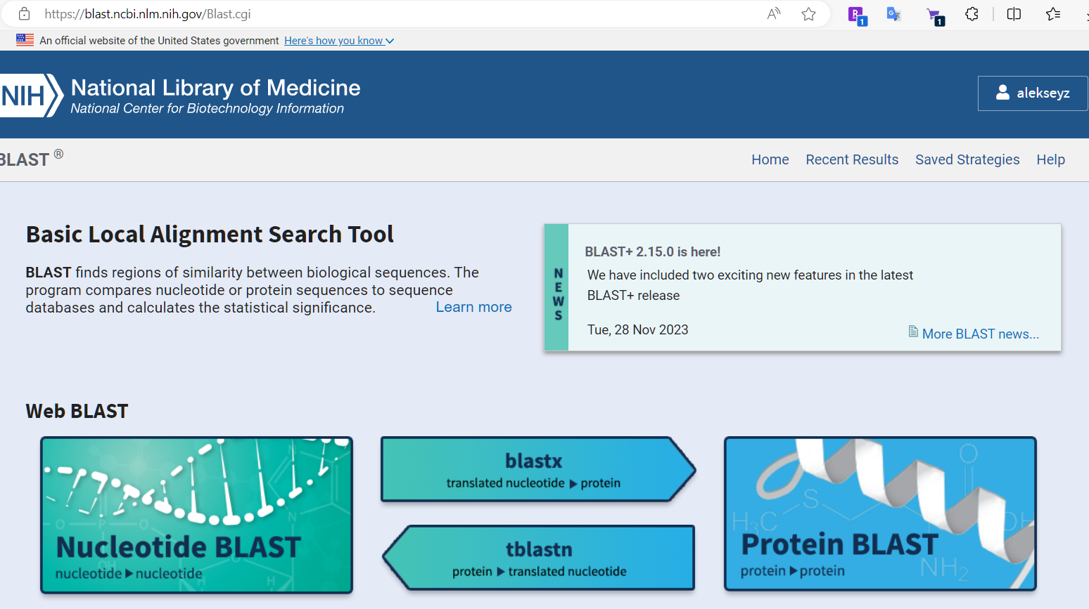
Alignment programs
Key Features of BLAST
Sequence Comparison: BLAST aligns query sequences (DNA, RNA, or protein) with database sequences.
Statistical Significance: It calculates the likelihood that the observed alignment occurred by chance (E-value).
Speed and Efficiency: BLAST uses heuristics, making it faster than traditional alignment algorithms like Smith-Waterman.
How BLAST Works
Seeding: BLAST identifies short, high-scoring K-mers (K=6) in the query sequence.
Extension: It extends these matches in both directions to form longer alignments.
Scoring: Alignments are scored based on substitution matrices (e.g., PAM, BLOSUM for proteins) or nucleotide match/mismatch scores.
Filtering: Low-scoring alignments are discarded, and significant matches are retained.
Blast – suite of aligners developed at NCBI
Online interface, useful for small sequences

Slide 70
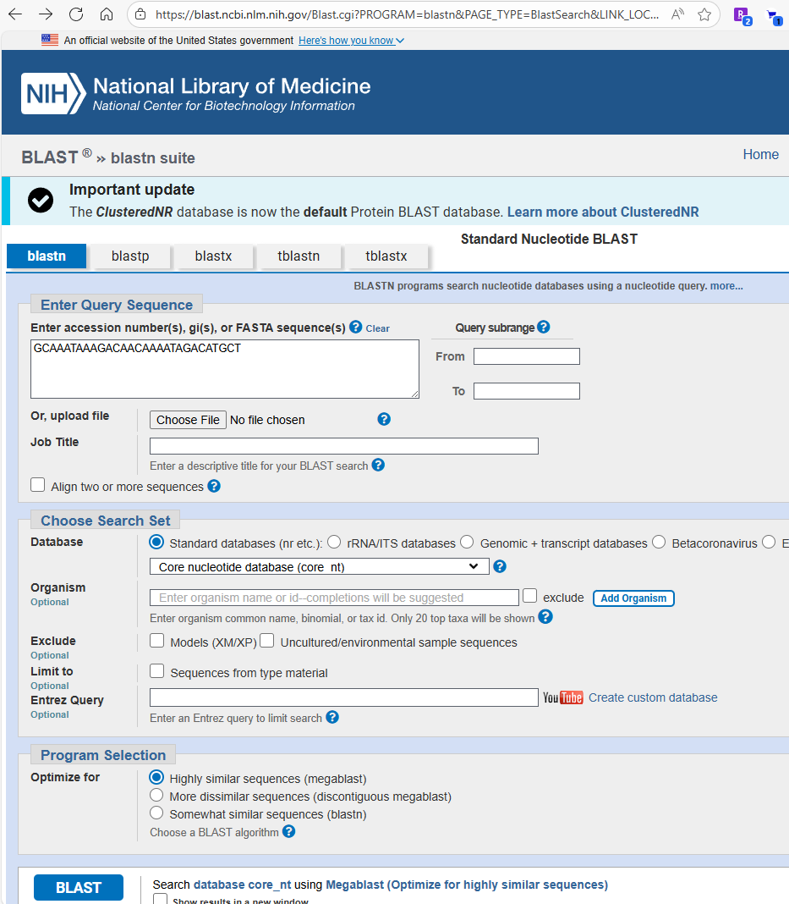
NCBI Blast online
Blastn– genome to genome
Blastp – protein to protein
Blastx – genome(trnsl) to protein
Tblastn – protein to genome (trnsl)
Tblastx -- genome(trnsl) to genome(trnsl)

Slide 71
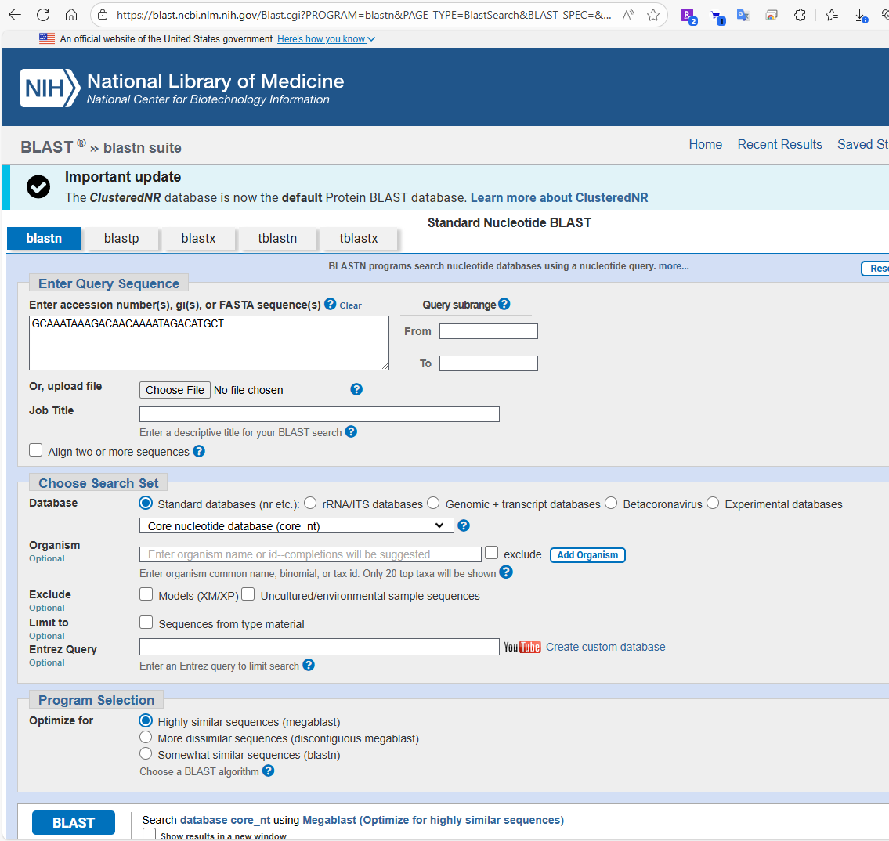
NCBI Blast online

Slide 72
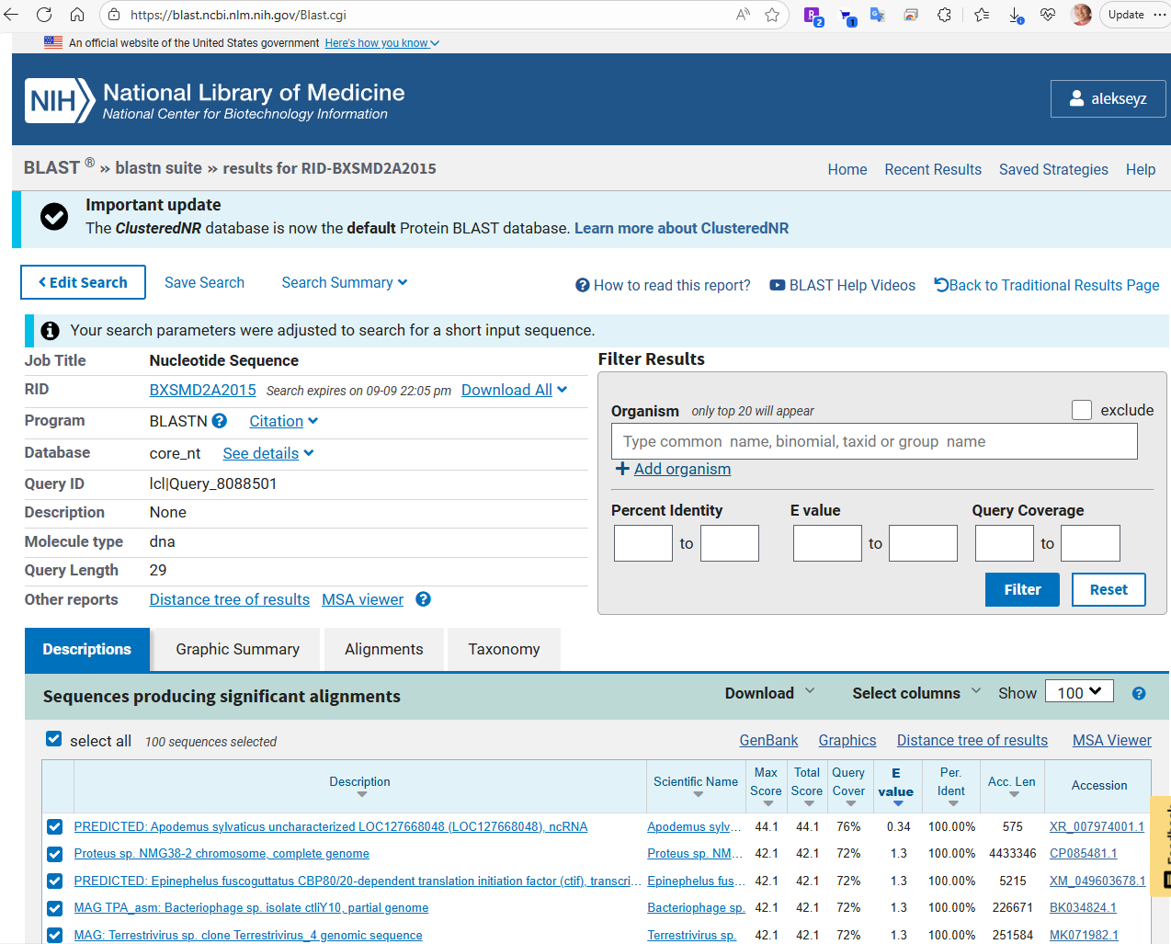
NCBI Blast online

Slide 73
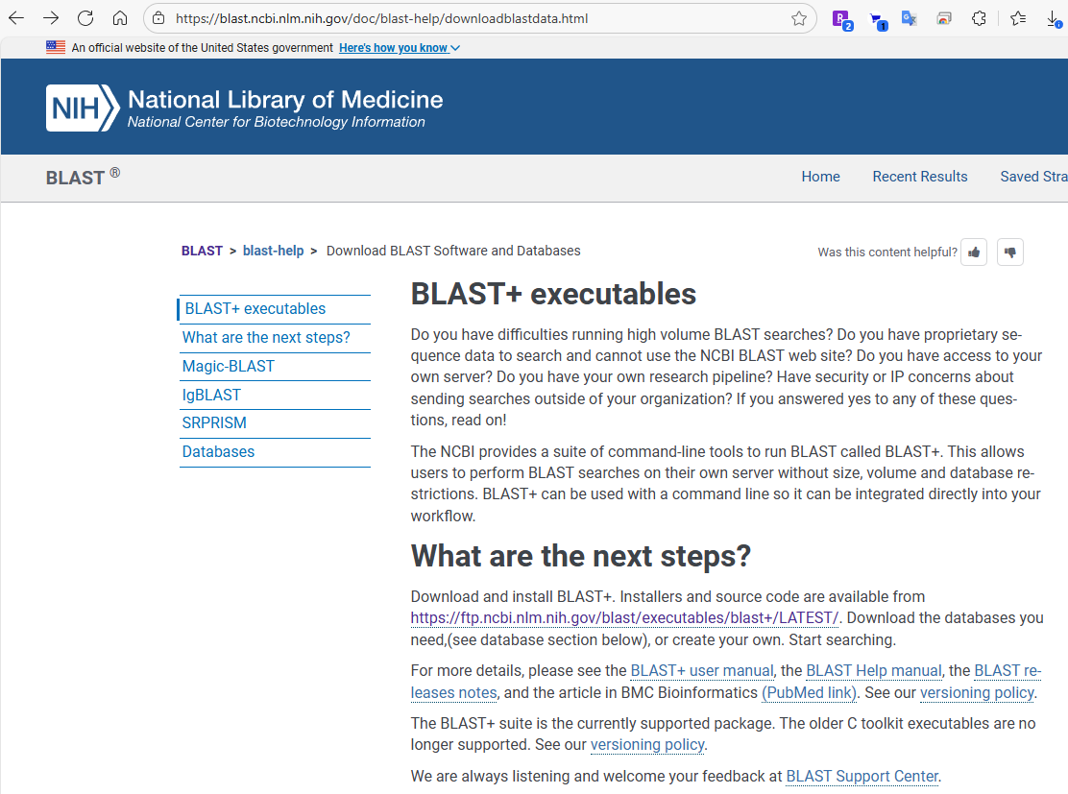
Local blast suite

Slide 74
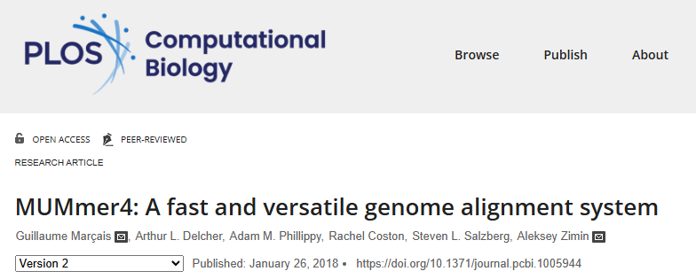
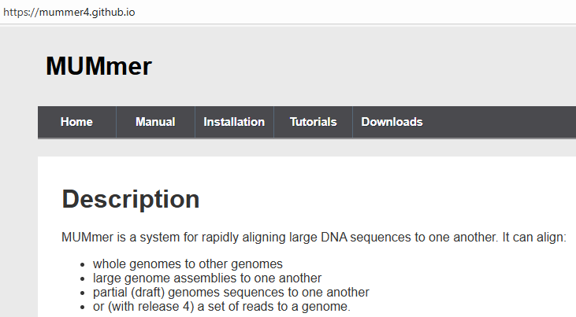
Alignment programs
Nucmer and promer (part of mummer package)
Used for DNA (nucmer) and protein (promer) sequence alignments
Based on suffix array, computes index of the reference

Slide 75
Nucmer aligner
nucmer is a general alignment tool for aligning DNA sequences
documentation https://mummer4.github.io/
fast, multi-threaded
virtually no limitation on sequence length
based on seeding the alignment with maximal exact matches (MUMs) and suffix arrays

Slide 76
Nucmer usage
nucmer –t <# threads> -p <prefix> reference.fa query.fa
output is in prefix.delta (can also output SAM format)
by default only uses seeds (MEMs or MUMs) that are unique in the reference!
Most useful options
-l minimum match length
-c minimum length of cluster of exact matches
--batch load reference in batches

Slide 77
Filtering/viewing nucmer output
delta-filter tool is used to filter the output delta file
show-aligns tool is used to display individual alignments
show-coords tool is used to display the alignment coordinates in human-readable coords format
most useful options
-l long output format
-c include percent coverage
-H remove header
-r sort alignments by reference coordinate

Slide 78
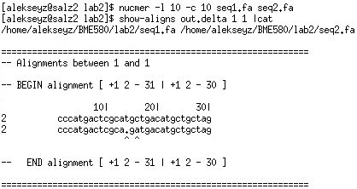
show-aligns output
Alignment: GCCCATGACTCGCATGCTGACATGCTGCTAGCT ||||||||||||| | |||||||||||||| | ACCCATGACTCGCA-GATGACATGCTGCTAGAT

Slide 79
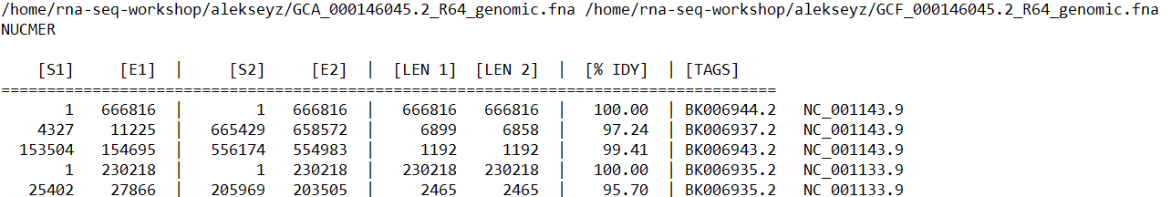
delta/coords format
delta files are produced by nucmer, can be converted to coords format with show-coords
coords format (depends on the options), all 1-based
It is possible to change the format with –l –c –H –r –q switches

Slide 80
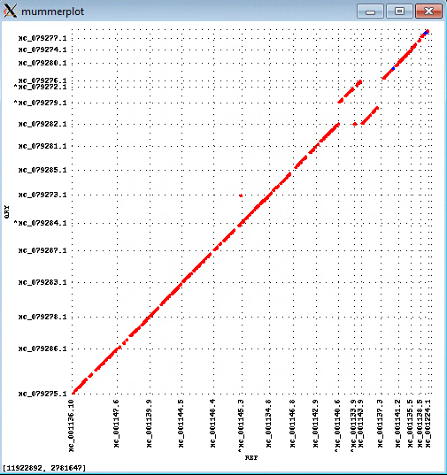

Filtering/viewing nucmer output
Mummerplot command will show the alignments as a plot
Align two strains of yeast (Saccharomyces cerevisiae and Saccharomyces kudriavzevii)

Slide 81
Filtering/viewing nucmer output
Mummerplot command will show the alignments as a plot
Align two strains of yeast (Saccharomyces cerevisiae and Saccharomyces kudriavzevii)

Slide 82
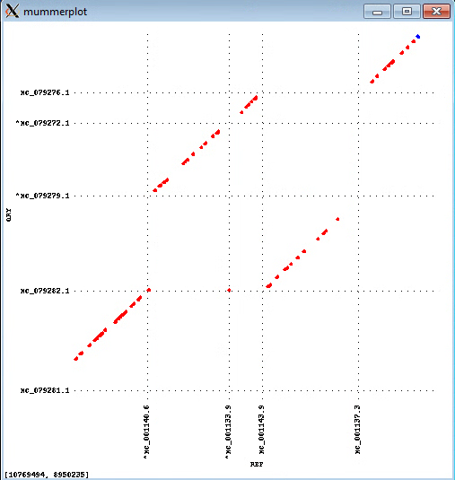
Filtering/viewing nucmer output
Mummerplot command will show the alignments as a plot
Align two strains of yeast (Saccharomyces cerevisiae and Saccharomyces kudriavzevii)

Slide 83
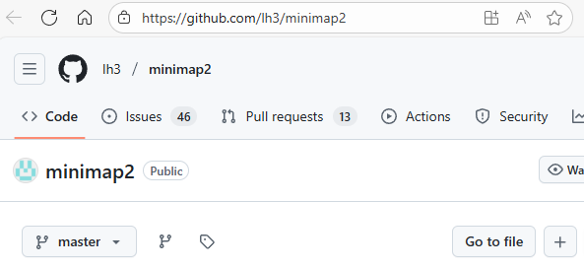
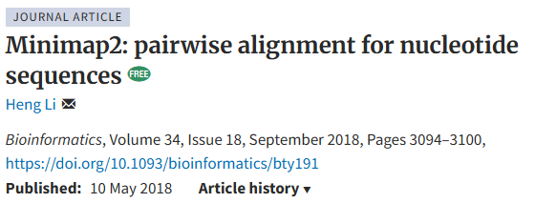
Alignment programs
Minimap2
based on minimizers

Slide 84
minimap2
minimap2 is a very fast aligner primarily useful for alignment of noisy long reads to the genome
Uses minimizers to seed alignments (k=15, w=10 by default)
Useful undocumented parameter: --secondary=no
Outputs Pairwise mApping Format (PAF) format by default, can output SAM format

Slide 85
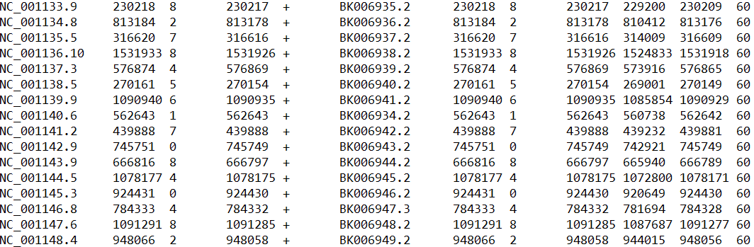
PAF format
Produced by minimap2, 0-based
If the first two bases of a read align then coordinates are (0 2)
Query Q_len Q_start Q_end Q_strand Reference R_len R_start R_end #_res bl_len MAP_Q

Slide 86
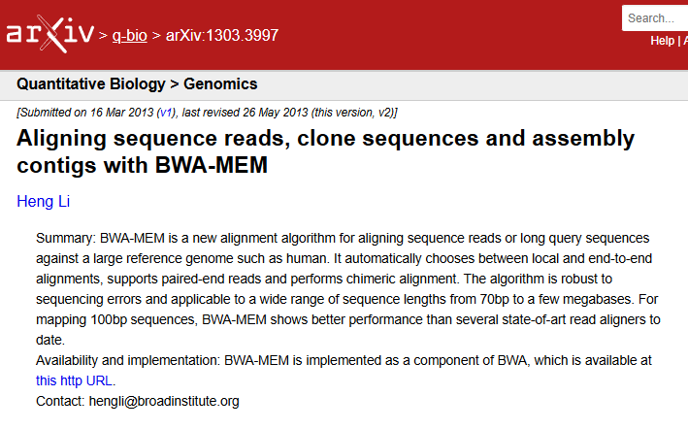
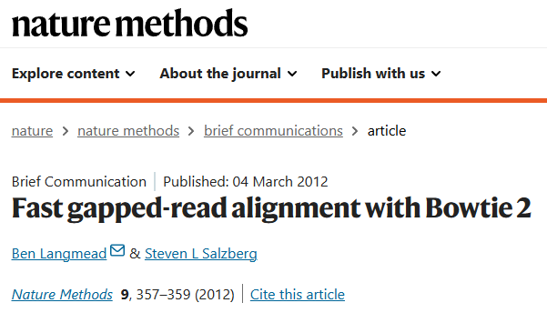
Alignment programs
Bowtie and BWA MEM
Used for alignment of short and long reads (BWA only) to the genome
Both based on BWT/SA

Slide 87
Alignment file formats
BED (Browser Extensible Data) – a nice format to represent alignment intervals
SAM/BAM – typically used for alignments of short reads to the genomic sequence
BAM is the compressed version of SAM
delta/coords – typically used for alignments of two genome sequences, used by mummer package
PAF – Pairwise mApping Format, output by minimap2

Slide 88
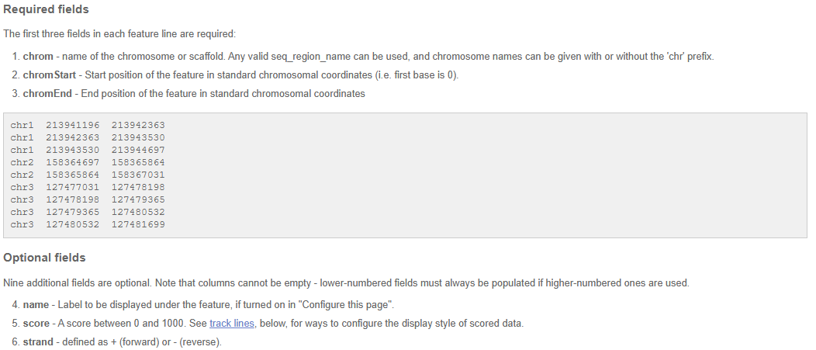
BED format
Source: https://useast.ensembl.org/info/website/upload/bed.html

Slide 89
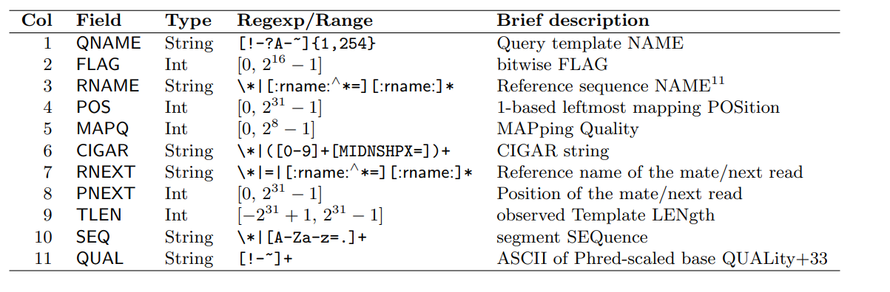
SAM format
Tab-separated file, human readable with the following columns
Missing or not defined values are *

Slide 90
SAM format
Tab-separated file, human readable with the following columns
Missing or not defined values are *

Slide 91
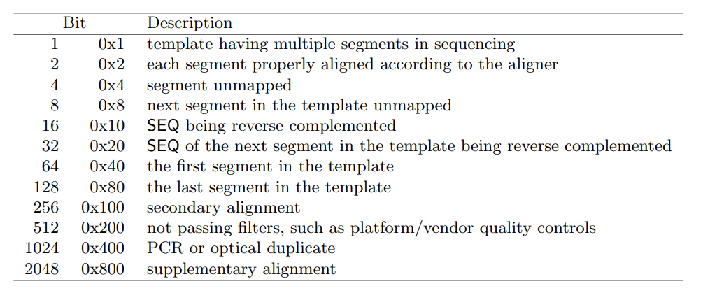
SAM format
FLAG field – 11 bits represented as decimal number
Most often used are 0, 16, and 2064
Conversion 000000010000₂ = 16

Slide 92
SAM format
Tab-separated file, human readable with the following columns
Missing or not defined values are *

Slide 93
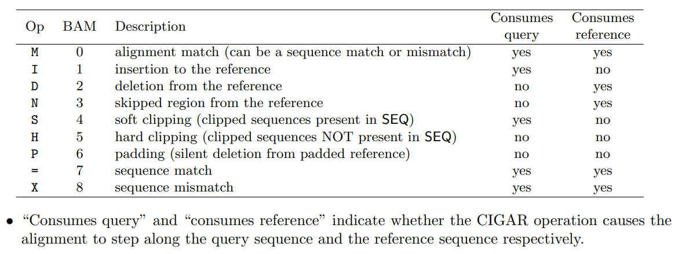
SAM format
CIGAR (Compact Idiosyncratic Gapped Alignment Report) string

Slide 94
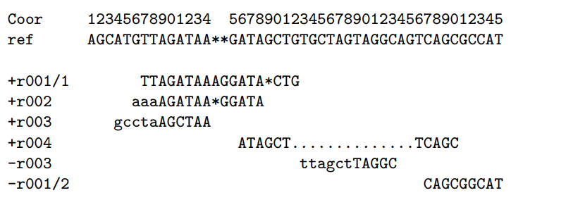
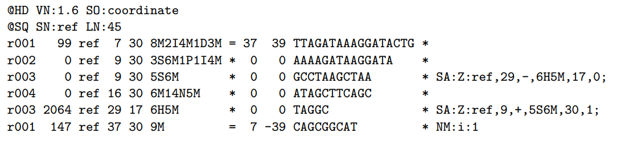
SAM format
Examples of CIGAR strings

Slide 95
SAM format https://samtools.github.io/hts-specs/SAMv1.pdf
Suppose we have the following alignment
It will look like this in the SAM file
Coordinates are 1-based

Slide 96
SAM format https://samtools.github.io/hts-specs/SAMv1.pdf
Suppose we have the following alignment
It will look like this in the SAM file
Coordinates are 1-based

Slide 97
SAM format https://samtools.github.io/hts-specs/SAMv1.pdf
Suppose we have the following alignment
It will look like this in the SAM file
Coordinates are 1-based

Slide 98
SAM format
“P” is needed to properly record full multi-alignment

Slide 99
SAM format https://samtools.github.io/hts-specs/SAMv1.pdf
Suppose we have the following alignment
It will look like this in the SAM file
Coordinates are 1-based

Slide 100
SAM format https://samtools.github.io/hts-specs/SAMv1.pdf
Suppose we have the following alignment
It will look like this in the SAM file
Coordinates are 1-based

Slide 101
SAM format https://samtools.github.io/hts-specs/SAMv1.pdf
Suppose we have the following alignment
It will look like this in the SAM file
Coordinates are 1-based

